Slide 1
TITLE
Task 2:Predicting customer buying behaviour

Slide 2
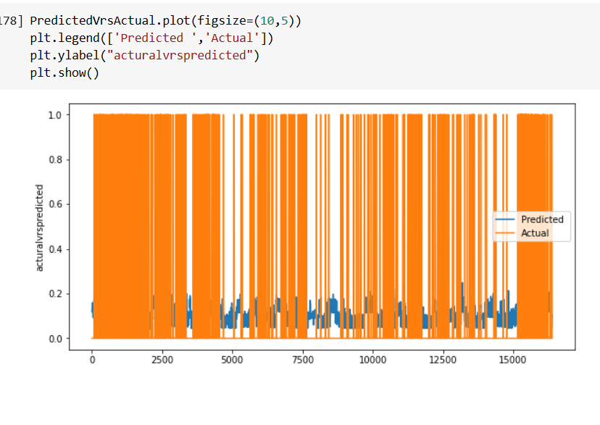
After running a regression model we see that the variables are not good for predicting booking completed.both r2 for test and train was close to showing that this variables are not good for prediction
If model is not well trained prediction becomes problematic resulting in the diagram below

